Slide 1



Noida Institute of Engineering and Technology, Greater Noida
Linked lists
Unit:2
Data Structures
Alisha Sikri
Assistant Professor
Computer Science and Engineering(AIML)
Course Details (B Tech 3rd Sem)

Slide 2
Syllabus
UNIT-2
Linked lists -Self-referential structure, Singly Linked List, Doubly Linked List, Circular Linked List.
Operations on a Linked List: Insertion, Deletion, Traversal, Reversal, Searching Polynomial Representation and Addition Subtraction & Multiplications of Polynomials.

Slide 3
Contents
Linked lists
Singly linked list, doubly linked list, circular linked list.
Operations on a Linked List: Insertion, deletion, traversal, reversal, searching.
Polynomial representation and addition, subtraction & multiplications of polynomials.

Slide 4
Objective of Unit
Objective of the course is to make students able to:
Learn the basic types for data structure, implementation and application.
Know the strength and weakness of different data structures.
3. Use the appropriate data structure in context of solution of given problem.
4. Develop programming skills which require to solve given problem.

Slide 5
Course Outcome
CO3: Compare and contrast the advantages and disadvantages of linked lists over arrays and implement operations on different types of linked list.

Slide 6
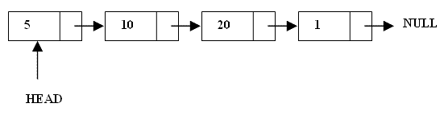
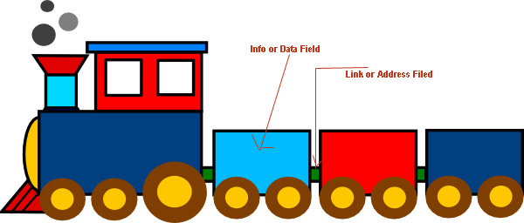
Linked Lists
Introduction to Link List(CO3)
A linked list is a linear data structure.
Nodes make up linked lists.
Nodes are structures made up of data and a pointer to another node.

Slide 7
Linked List
Introduction to Link List(CO3)
The elements of a linked list are not stored in adjacent memory location as in arrays.
It is a linear collection of data elements, called nodes, where the linear order is implemented by means of pointers.

Slide 8
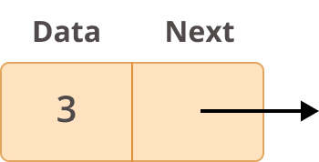
Linked List
Introduction to Link List(CO3)
In a linear or single-linked list, a node is connected to the next node by a single link.
A node in this type of linked list contains two types of fields:
data: which holds a list element
next: which stores a link (i.e. pointer) to the next node in the list.

Slide 9
Introduction to Link List(CO3)
Why Linked List?
Arrays can be used to store linear data of similar types, but arrays have the following limitations.
The size of the arrays is fixed: So we must know the upper limit on the number of elements in advance. Also, generally, the allocated memory is equal to the upper limit irrespective of the usage.
Inserting a new element in an array of elements is expensive because the room has to be created for the new elements and to create room existing elements have to be shifted.

Slide 10
Introduction to Link List(CO3)
Uses of Linked Lists
Due to their dynamic size allocation and ease of insertion/deletion, linked lists are applied in a lot of use cases.
They’re used to implement a lot of complex data structures like the adjacency list in graphs.
They are used for life-cycle management in operating systems.
A playlist in a music application is implemented using a doubly linked list.
Blockchain, a complex data structure that is used for cryptocurrencies and ledgers use a linked list at their core.

Slide 11
Properties of Linked list
Introduction to Link List(CO3)
The nodes in a linked list are not stored contiguously in the memory.
You don’t have to shift any element in the list.
Memory for each node can be allocated dynamically whenever the need arises.
The size of a linked list can grow or shrink dynamically.

Slide 12
Operations on Linked List
Introduction to Link List(CO3)
Creation:
This operation is used to create a linked list
Insertion / Deletion:
At/From the beginning of the linked list
At/From the end of the linked list
At/From the specified position in a linked list
Traversing:
Traversing may be either forward or backward
Searching:
Finding an element in a linked list

Slide 13
Arrays Vs Linked Lists
Link List(CO3)
Arrays | Linked list
Fixed size: Resizing is expensive | Dynamic size
Insertions and Deletions are inefficient: Elements are usually shifted | Insertions and Deletions are efficient: No shifting
Random access i.e., efficient indexing | No random access → Not suitable for operations requiring accessing elements by index such as sorting
No memory waste if the array is full or almost full; otherwise may result in much memory waste. | Since memory is allocated dynamically(acc. to our need) there is no waste of memory.
Sequential access is faster [Reason: Elements in contiguous memory locations] | Sequential access is slow [Reason: Elements not in contiguous memory locations]

Slide 14
Types of Linked List
Introduction to Link List(CO3)
Singly Linked List
Doubly linked list
Circular linked list

Slide 15
Singly Linked Lists
Link List(CO3)
Definition : head and tail
The first and last node of a linked list are known as the head and tail of the list, respectively.
Definition : traverse
By starting at the head, and moving from one node to another by following each node’s next reference, we can reach the tail of the list. We can identify the tail as the node having none as its next reference. This process is commonly known as traversing the linked list.

Slide 16
Singly Linked List
Introduction to Link List(CO3)
A singly linked list is a dynamic data structure which may grow or shrink, and growing and shrinking depends on the operation made.
In this type of linked list each node contains two fields one is data field which is used to store the data items and another is next field that is used to point the next node in the list.
info
next
info
next
info
next
5
3
8
null

Slide 17
1. Creating a List 2. Inserting an element in a list 3. Deleting an element from a list 4. Searching a list 5. Reversing a list
Introduction to Link List(CO3)

Slide 18
Creating a single Node:- For single node creation, we make a Node class that holds some data and a single pointer next, that will be used to point to the next Node type object in the Linked List.
Introduction to Link List(CO3)
# A single node of a singly linked list
class Node:
# constructor
def __init__(self, data, next=None):
self.data = data
self.next = next
# Creating a single node
first = Node(3)
print(first.data)
Nodetype *p;
p=(NodeType *) malloc (sizeof( NodeType ) ); p->info=50;
p->next = NULL;

Slide 19
class Node: def __init__(self, dataval=None): self.dataval = dataval self.nextval = None class SLinkedList: def __init__(self): self.headval = None list1 = SLinkedList() list1.headval = Node("Mon") e2 = Node("Tue") e3 = Node("Wed") # Link first Node to second node list1.headval.nextval = e2 # Link second Node to third node e2.nextval = e3
Introduction to Link List(CO3)
Creation of Linked list

Slide 20
Introduction to Link List(CO3)
Displaying a Single Linked List
We can use the following steps to display the elements of a single linked list...
Step 1 - Check whether list is Empty (head == NULL)
Step 2 - If it is Empty then, display 'List is Empty!!!' and terminate the function.
Step 3 - If it is Not Empty then, define a Node pointer 'temp' and initialize with head.
Step 4 - Keep displaying temp → data with an arrow (--->) until temp reaches to the last node
Step 5 - Finally display temp → data with arrow pointing to NULL (temp → data ---> NULL)

Slide 21
Inserting an Element
Introduction to Link List(CO3)
While inserting an element or a node in a linked list, we have to do following things:
Allocate a node
Assign a data to info field of the node.
Adjust a pointer
We can insert an element in following places
At the beginning of the linked list
At the end of the linked list
At the specified position in a linked list

Slide 22
Introduction to Link List(CO3)
Inserting at the Beginning
Inserting a new node at the beginning of a list is probably the most straightforward insertion .It’s all about creating a new node and then pointing the head of the list to it.

Slide 23
Introduction to Link List(CO3)
Inserting At Beginning of the list
We can use the following steps to insert a new node at beginning of the single linked list...
Step 1 - Create a newNode with given value.
Step 2 - Check whether list is Empty (head == NULL)
Step 3 - If it is Empty then, set newNode→next = NULL and head = newNode.
Step 4 - If it is Not Empty then, set newNode→next = head and head = newNode.

Slide 24
Introduction to Link List(CO3)
Inserting At Specific location in the list (After a Node)

Slide 25
Introduction to Link List(CO3)
Inserting At Specific location in the list (After a Node)
We can use the following steps to insert a new node after a node in the single linked list...
Step 1 - Create a newNode with given value.
Step 2 - Check whether list is Empty (head == NULL)
Step 3 - If it is Empty then, set newNode → next = NULL and head = newNode.
Step 4 - If it is Not Empty then, define a node pointer temp and initialize with head.

Slide 26
Introduction to Link List(CO3)
Inserting At Specific location in the list (After a Node)
Step 5 - Keep moving the temp to its next node until it reaches to the node after which we want to insert the newNode (until temp1 → data is equal to location, here location is the node value after which we want to insert the newNode).
Step 6 - Every time check whether temp is reached to last node or not. If it is reached to last node then display 'Given node is not found in the list!!! Insertion not possible!!!' and terminate the function. Otherwise move the temp to next node.
Step 7 - Finally, Set 'newNode → next = temp → next' and 'temp → next = newNode'

Slide 27
Introduction to Link List(CO3)
Inserting At End of the list
We can use the following steps to insert a new node at end of the single linked list...
Step 1 - Create a newNode with given value and newNode → next as NULL.
Step 2 - Check whether list is Empty (head == NULL).
Step 3 - If it is Empty then, set head = newNode.
Step 4 - If it is Not Empty then, define a node pointer temp and initialize with head.
Step 5 - Keep moving the temp to its next node until it reaches to the last node in the list (until temp → next is equal to NULL).
Step 6 - Set temp → next = newNode.

Slide 28
Introduction to Link List(CO3)
Inserting At End of the list

Slide 29
Introduction to Link List(CO3)
Deletion
In a single linked list, the deletion operation can be performed in three ways. They are as follows...
Deleting from Beginning of the list
Deleting from End of the list
Deleting a Specific Node

Slide 30
Introduction to Link List(CO3)
Deleting from Beginning of the list :-
the following steps to delete a node from beginning of the single linked list...
Step 1 - Check whether list is Empty (head == NULL)
Step 2 - If it is Empty then, display 'List is Empty!!! Deletion is not possible' and terminate the function.
Step 3 - If it is Not Empty then, define a Node pointer 'temp' and initialize with head.
Step 4 - Check whether list is having only one node (temp → next == NULL)
Step 5 - If it is TRUE then set head = NULL and delete temp (Setting Empty list conditions)
Step 6 - If it is FALSE then set head = temp → next, and delete temp.

Slide 31
Link List(CO3)
def pop_front(self):
if(self.head != None):
#1. if head is not null, create a
# temp node pointing to head
temp = self.head
#2. move head to next of head
self.head = self.head.next
#3. delete temp node
temp = None

Slide 32
Introduction to Link List(CO3)
Deleting from End of the list
Step 1 - Check whether list is Empty (head == NULL)
Step 2 - If it is Empty then, display 'List is Empty!!! Deletion is not possible' and terminate the function.
Step 3 - If it is Not Empty then, define two Node pointers 'temp1' and 'temp2' and initialize 'temp1' with head.
Step 4 - Check whether list has only one Node (temp1 → next == NULL)
Step 5 - If it is TRUE. Then, set head = NULL and delete temp1. And terminate the function. (Setting Empty list condition)
Step 6 - If it is FALSE. Then, set 'temp2 = temp1 ' and move temp1 to its next node. Repeat the same until it reaches to the last node in the list. (until temp1 → next == NULL)
Step 7 - Finally, Set temp2 → next = NULL and delete temp1.

Slide 33
Introduction to Link List(CO3)
Deleting from End of the list

Slide 34
Link List(CO3)
def remove_last(self):
#empty linkedlist
if self.head is None:
return None
#one node Linked list
if self.head.next is None:
self.head = None
return None
temp = self.head
while(temp.next is not None):
prev = temp
temp = temp.next
prev.next = None

Slide 35
Introduction to Link List(CO3)
Deleting a Specific Node from the list
Step 1 - Check whether list is Empty (head == NULL)
Step 2 - If it is Empty then, display 'List is Empty!!! Deletion is not possible' and terminate the function.
Step 3 - If it is Not Empty then, define two Node pointers 'temp1' and 'temp2' and initialize 'temp1' with head.
Step 4 - Keep moving the temp1 until it reaches to the exact node to be deleted or to the last node. And every time set 'temp2 = temp1' before moving the 'temp1' to its next node.
Step 5 - If it is reached to the last node then display 'Given node not found in the list! Deletion not possible!!!'. And terminate the function.

Slide 36
Introduction to Link List(CO3)
Deleting a Specific Node from the list
Step 6 - If it is reached to the exact node which we want to delete, then check whether list is having only one node or not.
Step 7 - If list has only one node and that is the node to be deleted, then set head = NULL and delete temp1 (free(temp1)).
Step 8 - If list contains multiple nodes, then check whether temp1 is the first node in the list (temp1 == head).
Step 9 - If temp1 is the first node then move the head to the next node (head = head → next) and delete temp1.
Step 10 - If temp1 is not first node then check whether it is last node in the list (temp1 → next == NULL).
Step 11 - If temp1 is last node then set temp2 → next = NULL and delete temp1 (free(temp1)).
Step 12 - If temp1 is not first node and not last node then set temp2 → next = temp1 → next and delete temp1 (free(temp1)).

Slide 37
Searching an item in a linked list
Introduction to Link List(CO3)
1) Initialize a node pointer, temp = head
2) Do following while temp is not NULL
temp->data is equal to the data being searched, return true.
temp = temp->next
3) Return false

Slide 38
Reverse a linked list
Introduction to Link List(CO3)
Initialize three pointers prev as NULL, curr as head and next as NULL.
Iterate through the linked list. In loop, do following. // Before changing next of current, // store next node next = curr->next // Now change next of current // This is where actual reversing happens curr->next = prev // Move prev and curr one step forward prev = curr curr = next

Slide 39
Reverse a linked list
Introduction to Link List(CO3)

Slide 40
Sorting of Linked List
#Represent a node of the singly linked list
class Node:
def __init__(self,data):
self.data = data;
self.next = None;
class SortList:
#Represent the head and tail of the singly linked list
def __init__(self):
self.head = None;
self.tail = None;
#addNode() will add a new node to the list
def addNode(self, data):
#Create a new node
newNode = Node(data);

Slide 41
#Checks if the list is empty
if(self.head == None):
#If list is empty, both head and tail will point to new node
self.head = newNode;
self.tail = newNode;
else:
#newNode will be added after tail such that tail's next will point to newNode
self.tail.next = newNode;
#newNode will become new tail of the list
self.tail = newNode;

Slide 42
#sortList() will sort nodes of the list in ascending order
def sortList(self):
#Node current will point to head
current = self.head;
index = None;
if(self.head == None):
return;
else:
while(current != None):
#Node index will point to node next to current
index = current.next;

Slide 43
while(index != None):
#If current node's data is greater than index's node data, swap the data between them
if(current.data > index.data):
temp = current.data;
current.data = index.data;
index.data = temp;
index = index.next;
current = current.next;

Slide 44
Display of the Linked List
#display() will display all the nodes present in the list
def display(self):
#Node current will point to head
current = self.head;
if(self.head == None):
print("List is empty");
return;
while(current != None):
#Prints each node by incrementing pointer
print(current.data),
current = current.next;
print ""

Slide 45
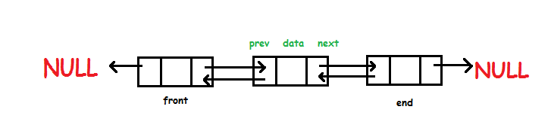
Link List(CO3)
Doubly Linked List
Doubly linked list is a type of linked list in which each node apart from storing its data has two links. The first link points to the previous node in the list and the second link points to the next node in the list. The first node of the list has its previous link pointing to NULL similarly the last node of the list has its next node pointing to NULL.
The two links help us to traverse the list in both backward and forward direction. But storing an extra link requires some extra space.

Slide 46
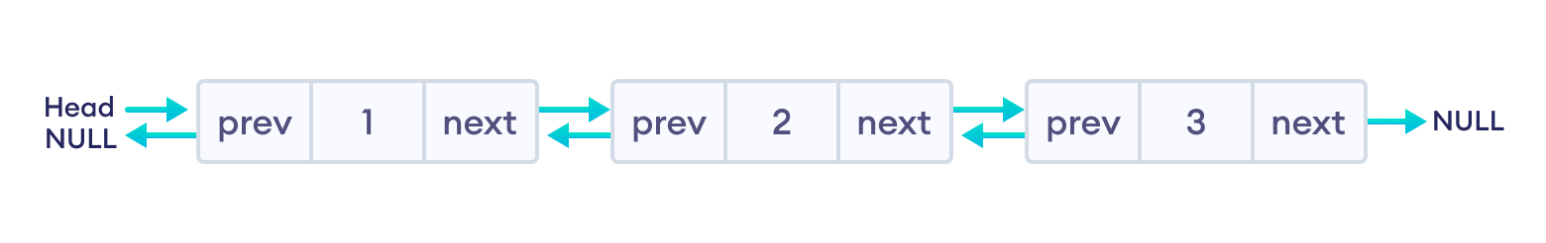
Link List(CO3)
Following are the important terms to understand the concept of doubly linked list.
Link − Each link of a linked list can store a data called an element.
Next − Each link of a linked list contains a link to the next link called Next.
Prev − Each link of a linked list contains a link to the previous link called Prev.
LinkedList − A Linked List contains the connection link to the first link called First and to the last link called Last.
Doubly Linked List Representation

Slide 47
Link List(CO3)
Operations on Double Linked List
In a double linked list, we perform the following operations...
1. Insertion
2. Deletion
3. Display

Slide 48
Link List(CO3)
Insertion
In a double linked list, the insertion operation can be performed in three ways as follows...
1. Inserting At Beginning of the list
2. Inserting At End of the list
3. Inserting At Specific location in the list

Slide 49
Link List(CO3)
Inserting At Beginning of the list
We can use the following steps to insert a new node at beginning of the double linked list...
• Step 1 - Create a newNode with given value and newNode → previous as NULL.
• Step 2 - Check whether list is Empty (head == NULL)
• Step 3 - If it is Empty then, assign NULL to newNode → next and newNode to head.
• Step 4 - If it is not Empty then, assign newNode → next=head, head->prev = NULL and head= newNode.

Slide 50
Link List(CO3)
Inserting At End of the list
• Step 1 - Create a newNode with given value and newNode → next as NULL.
• Step 2 - Check whether list is Empty (head == NULL)
• Step 3 - If it is Empty, then assign NULL to newNode → previous and newNode to head.
• Step 4 - If it is not Empty, then, define a node pointer temp and initialize with head.
• Step 5 - Keep moving the temp to its next node until it reaches to the last node in the list (until temp → next is equal to NULL).
• Step 6 - Assign newNode to temp → next and temp to newNode → previous.

Slide 51
Link List(CO3)
Inserting At Specific location in the list (After a Node)
• Step 1 - Create a newNode with given value.
• Step 2 - Check whether list is Empty (head == NULL)
• Step 3 - If it is Empty then, assign NULL to both newNode → previous & newNode → next and set newNode to head.
• Step 4 - If it is not Empty then, define two node pointers temp1 & temp2 and initialize temp1 with head.

Slide 52
Link List(CO3)
Inserting At Specific location in the list (After a Node)
• Step 5 - Keep moving the temp1 to its next node until it reaches to the node after which we want to insert the newNode (until temp1 → data is equal to location, here location is the node value after which we want to insert the newNode).
• Step 6 - Every time check whether temp1 is reached to the last node. If it is reached to the last node then display 'Given node is not found in the list!!! Insertion not possible!!!' and terminate the function. Otherwise move the temp1 to next node.
• Step 7 - Assign temp1 → next to temp2, newNode to temp1 → next, temp1 to newNode → previous, temp2 to newNode → next and newNode to temp2 → previous.

Slide 53
Link List(CO3)
Deletion
In a double linked list, the deletion operation can be performed in three ways as follows...
1. Deleting from Beginning of the list
2. Deleting from End of the list
3. Deleting a Specific Node

Slide 54
Link List(CO3)
Deleting from Beginning of the list
• Step 1 - Check whether list is Empty (head == NULL)
• Step 2 - If it is Empty then, display 'List is Empty!!! Deletion is not possible' and terminate the function.
• Step 3 - If it is not Empty then, define a Node pointer 'temp' and initialize with head.
• Step 4 - Check whether list is having only one node (temp → previous is equal to temp → next)
• Step 5 - If it is TRUE, then set head = NULL and delete temp (Setting Empty list conditions)
• Step 6 - If it is FALSE, then assign head=temp → next, head → previous =NULL and delete temp.

Slide 55
Link List(CO3)
Deleting from End of the list
• Step 1 - Check whether list is Empty (head == NULL)
• Step 2 - If it is Empty, then display 'List is Empty!!! Deletion is not possible' and terminate the function.
• Step 3 - If it is not Empty then, define a Node pointer 'temp' and initialize with head.
• Step 4 - Check whether list has only one Node (temp → previous and temp → next both are NULL)
• Step 5 - If it is TRUE, then assign NULL to head and delete temp. And terminate from the function. (Setting Empty list condition)
• Step 6 - If it is FALSE, then keep moving temp until it reaches to the last node in the list. (until temp → next is equal to NULL)
• Step 7 - Assign NULL to temp → previous → next and delete temp.

Slide 56
Link List(CO3)
Deleting a Specific Node from the list
• Step 1 - Check whether list is Empty (head == NULL)
• Step 2 - If it is Empty then, display 'List is Empty!!! Deletion is not possible' and terminate the function.
• Step 3 - If it is not Empty, then define a Node pointer 'temp' and initialize with head.
• Step 4 - Keep moving the temp until it reaches to the exact node to be deleted or to the last node.
• Step 5 - If it is reached to the last node, then display 'Given node not found in the list! Deletion not possible!!!' and terminate the fuction.
• Step 6 - If it is reached to the exact node which we want to delete, then check whether list is having only one node or not

Slide 57
Link List(CO3)
Step 7 - If list has only one node and that is the node which is to be deleted then set head to NULL and delete temp (free(temp)).
• Step 8 - If list contains multiple nodes, then check whether temp is the first node in the list (temp == head).
• Step 9 - If temp is the first node, then move the head to the next node (head = head → next), set head of previous to NULL (head → previous = NULL) and delete temp.
• Step 10 - If temp is not the first node, then check whether it is the last node in the list (temp → next == NULL).
• Step 11 - If temp is the last node then set temp of previous of next to NULL (temp → previous → next = NULL) and delete temp (free(temp)).
• Step 12 - If temp is not the first node and not the last node, then set temp of previous of next to temp of next (temp → previous → next = temp → next), temp of next of previous to temp of previous (temp → next → previous = temp → previous) and delete temp (free(temp)).

Slide 58
Link List(CO3)
Displaying a Double Linked List
• Step 1 - Check whether list is Empty (head == NULL)
• Step 2 - If it is Empty, then display 'List is Empty!!!' and terminate the function.
• Step 3 - If it is not Empty, then define a Node pointer 'temp' and initialize with head.
• Step 4 - Display 'NULL <--- '.
• Step 5 - Keep displaying temp → data with an arrow (<===>) until temp reaches to the last node
• Step 6 - Finally, display temp → data with arrow pointing to NULL (temp → data ---> NULL).

Slide 59
Creating a node
class Node:
def __init__(self, data):
self.item = data
self.next = None
self.prev = None
class doublyLinkedList:
def __init__(self):
self.start_node = None

Slide 60
Inserting elements to Empty List
def InsertToEmptyList(self, data):
if self.start_node is None:
new_node = Node(data)
self.start_node = new_node
else:
print("The list is empty")

Slide 61
Inserting elements at the end
# Insert element at the end
def InsertToEnd(self, data):
# Check if the list is empty
if self.start_node is None:
new_node = Node(data)
self.start_node = new_node
return
n = self.start_node
# Iterate till the next reaches NULL
while n.next is not None:
n = n.next
new_node = Node(data)
n.next = new_node
new_node.prev = n

Slide 62
Deleting elements from the start
# Delete the elements from the start
def DeleteAtStart(self):
if self.start_node is None:
print("The Linked list is empty, no element to delete")
return
if self.start_node.next is None:
self.start_node = None
return
self.start_node = self.start_node.next
self.start_prev = None;

Slide 63
Deleting elements from the End
# Delete the elements from the end
def delete_at_end(self):
# Check if the List is empty
if self.start_node is None:
print("The Linked list is empty, no element to delete")
return
if self.start_node.next is None:
self.start_node = None
return
n = self.start_node
while n.next is not None:
n = n.next
n.prev.next = None

Slide 64
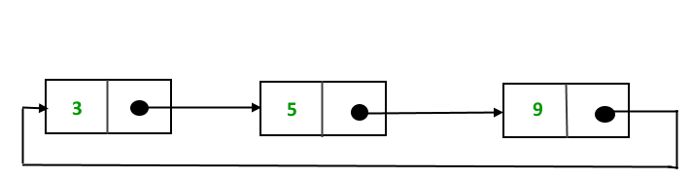
Circular linked list
Circular Link List(CO3)
Circular linked list is a variation of linked list in which the first elements points to the next element and the last element points to the first element.
Both singly and doubly linked list can be made into a circular linked list. Circular linked list can be used to help traverse the same list again and again if needed.

Slide 65
Advantages of Circular linked lists:
Circular Link List(CO3)
Any node can be a starting point. We can traverse the whole list by starting from any point. We just need to stop when the first visited node is visited again.
Circular lists are useful in applications to repeatedly go around the list.
Circular Doubly Linked Lists are used for implementation of advanced data structures like Fibonacci Heap.

Slide 66
Disadvantages of Circular linked list
Circular Link List(CO3)
Depending on the implementation, inserting at start of list would require doing a search for last node which could be expensive.
Finding end of the list and loop control is harder ( no NULL’s to mark the beginning and end).

Slide 67
Operations on singly circular linked list
Circular Link List(CO3)
Insertion
Deletion
Display

Slide 68
Insertion
Circular Link List(CO3)
Insertion can be of three types.
▫ Insert at first
▫ Insert at last
▫ Insert after constant
Note: insertion after constant in circular and linear linked list is exact same .

Slide 69
Circular Link List(CO3)
Inserting At Beginning of the list
Step 1 - Create a newNode with given value.
Step 2 - Check whether list is Empty (head == NULL)
Step 3 - If it is Empty then, set head = newNode and newNode→next = head .
Step 4 - If it is Not Empty then, define a Node pointer 'temp' and initialize with 'head'.
Step 5 - Keep moving the 'temp' to its next node until it reaches to the last node (until 'temp → next == head').
Step 6 - Set 'newNode → next =head', 'head = newNode' and 'temp → next = head'.

Slide 70
Circular Link List(CO3)
Inserting At End of the list
Step 1 - Create a newNode with given value.
Step 2 - Check whether list is Empty (head == NULL).
Step 3 - If it is Empty then, set head = newNode and newNode → next = head.
Step 4 - If it is Not Empty then, define a node pointer temp and initialize with head.
Step 5 - Keep moving the temp to its next node until it reaches to the last node in the list (until temp → next == head).
Step 6 - Set temp → next = newNode and newNode → next = head.

Slide 71
Circular Link List(CO3)
Inserting At Specific location in the list (After a Node)
Step 1 - Create a newNode with given value.
Step 2 - Check whether list is Empty (head == NULL)
Step 3 - If it is Empty then, set head = newNode and newNode → next = head.
Step 4 - If it is Not Empty then, define a node pointer temp and initialize with head.
Step 5 - Keep moving the temp to its next node until it reaches to the node after which we want to insert the newNode (until temp1 → data is equal to location, here location is the node value after which we want to insert the newNode).

Slide 72
Circular Link List(CO3)
Inserting At Specific location in the list (After a Node)
Step 6 - Every time check whether temp is reached to the last node or not. If it is reached to last node then display 'Given node is not found in the list!!! Insertion not possible!!!' and terminate the function. Otherwise move the temp to next node.
Step 7 - If temp is reached to the exact node after which we want to insert the newNode then check whether it is last node (temp → next == head).
Step 8 - If temp is last node then set temp → next = newNode and newNode → next = head.
Step 8 - If temp is not last node then set newNode → next = temp → next and temp → next = newNode

Slide 73
Deletion :
Circular Link List(CO3)
Deletion can be of three types.
▫ Delete from front
▫ Delete from last
▫ Deletion from mid
Note: deletion from mid in circular and linear linked list is exact same .

Slide 74
Deleting from Beginning of the list Step 1 - Check whether list is Empty (head == NULL) Step 2 - If it is Empty then, display 'List is Empty!!! Deletion is not possible' and terminate the function. Step 3 - If it is Not Empty then, define two Node pointers 'temp1' and 'temp2' and initialize both 'temp1' and 'temp2' with head. Step 4 - Check whether list is having only one node (temp1 → next == head) Step 5 - If it is TRUE then set head = NULL and delete temp1 (Setting Empty list conditions) Step 6 - If it is FALSE move the temp1 until it reaches to the last node. (until temp1 → next == head ) Step 7 - Then set head = temp2 → next, temp1 → next = head and delete temp2.
Circular Link List(CO3)

Slide 75
Deleting from End of the list Step 1 - Check whether list is Empty (head == NULL) Step 2 - If it is Empty then, display 'List is Empty!!! Deletion is not possible' and terminate the function. Step 3 - If it is Not Empty then, define two Node pointers 'temp1' and 'temp2' and initialize 'temp1' with head. Step 4 - Check whether list has only one Node (temp1 → next == head) Step 5 - If it is TRUE. Then, set head = NULL and delete temp1. And terminate from the function. (Setting Empty list condition) Step 6 - If it is FALSE. Then, set 'temp2 = temp1 ' and move temp1 to its next node. Repeat the same until temp1 reaches to the last node in the list. (until temp1 → next == head) Step 7 - Set temp2 → next = head and delete temp1.
Circular Link List(CO3)

Slide 76
Displaying a circular Linked List Step 1 - Check whether list is Empty (head == NULL) Step 2 - If it is Empty, then display 'List is Empty!!!' and terminate the function. Step 3 - If it is Not Empty then, define a Node pointer 'temp' and initialize with head. Step 4 - Keep displaying temp → data with an arrow (--->) until temp reaches to the last node Step 5 - Finally display temp → data with arrow pointing to head → data.
Circular Link List(CO3)

Slide 77
1. Implementation of stacks and queues. 2. Implementation of graphs : Adjacency list representation of graphs is most popular which is uses linked list to store adjacent vertices. 3. Dynamic memory allocation : We use linked list of free blocks. 4. Maintaining directory of names. 5. Manipulation of polynomials by storing constants in the node of linked list . 5. representing sparse matrices.
Link List(CO3)
Applications of linked list in computer science –

Slide 78
Introduction to Link List(CO3)
Polynomials
Polynomials are the algebraic expressions which consist of variables and coefficients.
Example -
10x² + 26x, here 10 and 26 are coefficients and 2, 1 is its exponential value.

Slide 79
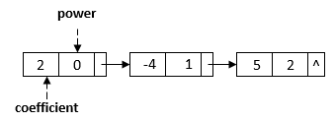
Introduction to Link List(CO3)
Represent a Polynomial with a Linked List
We can use a linked list to represent a polynomial. In the linked list, each node has two data fields: coefficient and power. Therefore, each node represents a term of a polynomial. For example, we can represent the polynomial with a linked list:

Slide 80

Link List(CO3)
Linked list Implementation:
p1(x) = 23x⁹ + 18x⁷ + 41x⁶ + 163x⁴ + 3
p2(x) = 4x⁶ + 10x⁴ + 12x + 8
23 9
18 7
41 6
163 4
3
P1
0
Next (contains pointer)
4 6
10 4
12 1
8 0
P2
NODE (contains coefficient & exponent)

Slide 81
Introduction to Link List(CO3)
Addition of Polynomials
Example:
Input:
1st number = 5x² + 4x¹ + 2x⁰
2nd number = -5x¹ - 5x⁰
Output:
5x²-1x¹-3x⁰

Slide 82
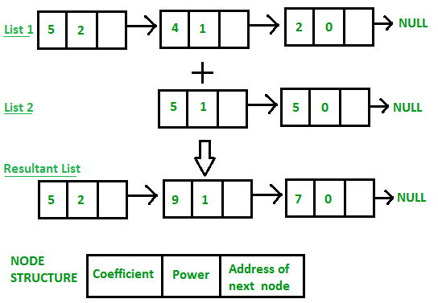
Introduction to Link List(CO3)
Addition of Polynomials

Slide 83
Introduction to Link List(CO3)
Multiplication of two polynomials using Linked list
Input:
Poly1: 3x^2 + 5x^1 + 6,
Poly2: 6x^1 + 8
Output:
18x^3 + 54x^2 + 76x^1 + 48
On multiplying each element of 1st polynomial with elements of 2nd polynomial, we get 18x^3 + 24x^2 + 30x^2 + 40x^1 + 36x^1 + 48 On adding values with same power of x, 18x^3 + 54x^2 + 76x^1 + 48

Slide 84
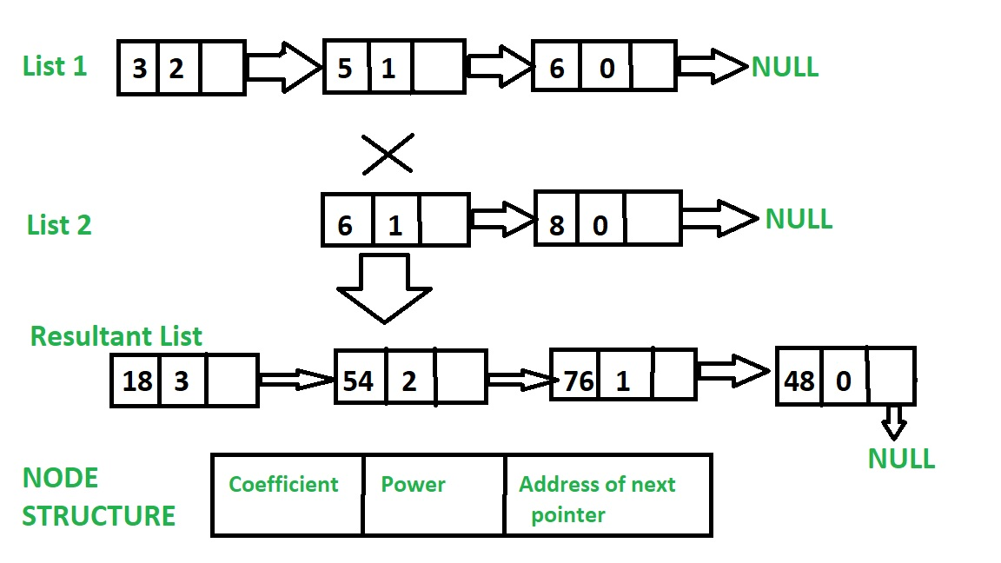
Introduction to Link List(CO3)
Multiplication of two polynomials using Linked list

Slide 85
Daily Quiz
Q3. Describe what is Node in link list? And name the types of Linked Lists?
Q4. Mention what is the difference between Linear Array and Linked List?
Q5. Mention what are the applications of Linked Lists?
Q6. What does the dummy header in linked list contain?
Q7. Mention what is the difference between singly and doubly linked lists?
Q8. Mention what is the biggest advantage of linked lists?
Q9. Mention how to insert a new node in linked list where free node will be available?

Slide 86
Expected Questions for University Exam
Q1. Write a program in c to delete a specific element in single linked list. Double linked list takes more space than single linked list for storing one extra address. Under what condition, could a double linked list more beneficial than single linked list.
Q2. What is a doubly linked list? How is it different from the single linked list?
Q3. What are the advantages and disadvantages of array over linked list?
Q4 . Write a program to implement linear linked list, showing all the operations that
can be performed on a linked list.
Q5. Implement Doubly Circular link list and insert an element at a given position in the doubly circular link list.

Slide 87
Old Question Papers
https://drive.google.com/open?id=15fAkaWQ5ccZRZPzwlP4PBh1LxcPp4VAd

Slide 88
References
Fundamentals of Data Structures in C by Horowitz, Sahni and Anderson-Freed.
Data Structures Through C in Depth by S.K Srivastava, Deepali Srivastava.
Data Structure using c by R Krishanamoorty.
Data Structures by Lipschutz, Schaum’s Outline Series, Tata McGraw-hill Education (India) Pvt. Ltd.
Data Structure Using C by Reema Thareja, Oxford Higher Education.
Data Structure Using C by AK Sharma, Pearson Education India.

Slide 89
MCQ
1. Which of the following is not a disadvantage to the usage of array? a) Fixed size b) There are chances of wastage of memory space if elements inserted in an array are lesser than the allocated size c) Insertion based on position d) Accessing elements at specified positions

Slide 90
MCQ
2. Which of these is not an application of a linked list? a) To implement file systems b) For separate chaining in hash-tables c) To implement non-binary trees d) Random Access of elements

Slide 91
MCQ
3.A linear collection of data elements where the linear node is given by means of pointer is called?
A. linked list B. node list C. primitive list D. None of these

Slide 92
MCQ
4. Linked lists are not suitable to for the implementation of?
A. Insertion sort B. Radix sort C. Polynomial manipulation D. Binary search

Slide 93
MCQ
5. In circular linked list, insertion of node requires modification of?
A. One pointer B. Two pointer C. Three pointer D. None

Slide 94
MCQ
6. In a circular linked list a) Components are all linked together in some sequential manner. b) There is no beginning and no end. c) Components are arranged hierarchically. d) Forward and backward traversal within the list is permitted.

Slide 95
MCQ
7. A linear collection of data elements where the linear node is given by means of pointer is called? a) Linked list b) Node list c) Primitive list d) None

Slide 96
MCQ
8. Which of the following operations is performed more efficiently by doubly linked list than by singly linked list? a) Deleting a node whose location in given b) Searching of an unsorted list for a given item c) Inverting a node after the node with given location d) Traversing a list to process each node

Slide 97
MCQ
9. In linked list each node contain minimum of two fields. One field is data field to store the data second field is? a) Pointer to character b) Pointer to integer c) Pointer to node d) Node

Slide 98
MCQ
10. The concatenation of two list can performed in O(1) time. Which of the following variation of linked list can be used? a) Singly linked list b) Doubly linked list c) Circular doubly linked list d) Array implementation of list

Slide 99
Old Question Papers
https://drive.google.com/open?id=15fAkaWQ5ccZRZPzwlP4PBh1LxcPp4VAd

Slide 100
References
[1] Aaron M. Tenenbaum, Yedidyah Langsam and Moshe J. Augenstein, “Data Structures Using C and C++”, PHI Learning Private Limited, Delhi India
[2] Horowitz and Sahani, “Fundamentals of Data Structures”, Galgotia Publications Pvt Ltd Delhi India.
[3] Lipschutz, “Data Structures” Schaum’s Outline Series, Tata McGraw-hill Education (India) Pvt. Ltd.
[4] Thareja, “Data Structure Using C” Oxford Higher Education.
[5] AK Sharma, “Data Structure Using C”, Pearson Education India.

Slide 101
Thank you

